Slide 1



Do not edit
How to change the design
Join at slido.com #2619759
Presenting with animations, GIFs or speaker notes? Enable our Chrome extension
Notes:
📣 This is Slido interaction slide, please don't delete it. ✅ Click on 'Present with Slido' and the joining instructions will appear when you get to this slide.

Slide 2

Do not edit
How to change the design
How can you prevent yourself from cloud over billing?
Presenting with animations, GIFs or speaker notes? Enable our Chrome extension
Notes:
📣 This is Slido interaction slide, please don't delete it. ✅ Click on 'Present with Slido' and the poll will launch automatically when you get to this slide.

Slide 3

Do not edit
How to change the design
What is your first OS?
Presenting with animations, GIFs or speaker notes? Enable our Chrome extension
Notes:
📣 This is Slido interaction slide, please don't delete it. ✅ Click on 'Present with Slido' and the poll will launch automatically when you get to this slide.

Slide 4
Cloud Operating Systems and Servers
The way to manage hardware and software resources in a cloud environment

Slide 5
Introduction to Cloud Operating Systems
Cloud Operating System (Cloud OS) manages hardware and software resources in a cloud environment.
It acts as a platform for cloud applications to run.
Enables scalability, virtualization, and multi-tenancy.
Examples: OpenStack, Windows Azure, Google Cloud OS.

Slide 6

Do not edit
How to change the design
Which of the following best defines a Cloud Operating System?
Presenting with animations, GIFs or speaker notes? Enable our Chrome extension
Notes:
📣 This is Slido interaction slide, please don't delete it. ✅ Click on 'Present with Slido' and the poll will launch automatically when you get to this slide.

Slide 7
Role of Cloud Operating System
Manages Virtual Machines (VMs): Provision, monitor, and destroy VMs.
Resource Management: Allocates CPU, memory, and storage dynamically.
User & Access Management: Multi-user, multi-tenant support.
Scalability & Elasticity: Supports automatic scaling.
Automation: Automated deployment, monitoring, and fault tolerance.

Slide 8
Do not edit
How to change the design
Which of the following is NOT a key function of a Cloud OS?
Presenting with animations, GIFs or speaker notes? Enable our Chrome extension
Notes:
📣 This is Slido interaction slide, please don't delete it. ✅ Click on 'Present with Slido' and the poll will launch automatically when you get to this slide.

Slide 9
Types of Cloud Operating Systems
Open Source Cloud OS: OpenStack, CloudStack.
Proprietary Cloud OS: Microsoft Azure, Google Cloud OS.
Hybrid Solutions: Combining private and public features.

Slide 10
Do not edit
How to change the design
Which of these is an open-source Cloud OS?
Presenting with animations, GIFs or speaker notes? Enable our Chrome extension
Notes:
📣 This is Slido interaction slide, please don't delete it. ✅ Click on 'Present with Slido' and the poll will launch automatically when you get to this slide.

Slide 11
Cloud Servers - Introduction
Cloud servers are virtual servers running in a cloud environment.
Hosted by cloud providers like AWS, Azure, GCP.
Highly scalable and can be deployed globally.
Types: Compute, Database, Storage, App Servers.

Slide 12
Do not edit
How to change the design
What is a key benefit of using cloud servers?
Presenting with animations, GIFs or speaker notes? Enable our Chrome extension
Notes:
📣 This is Slido interaction slide, please don't delete it. ✅ Click on 'Present with Slido' and the poll will launch automatically when you get to this slide.

Slide 13
Types of Cloud Servers
Compute Servers (EC2, VM Instances).
Database Servers (RDS, Cloud SQL).
Storage Servers (S3, Blob Storage).
Application Servers (App Engine, Elastic Beanstalk).

Slide 14
Do not edit
How to change the design
Which type of server is used primarily for computing in the cloud?
Presenting with animations, GIFs or speaker notes? Enable our Chrome extension
Notes:
📣 This is Slido interaction slide, please don't delete it. ✅ Click on 'Present with Slido' and the poll will launch automatically when you get to this slide.

Slide 15
Key Features of Cloud Operating System
Elastic Scaling: Automatically scales resources up/down.
API Access: Provides programmatic access to all services.
Resource Pooling: Combines resources for multi-tenancy.
Self-service Portals: Web interfaces for users to manage services.
Monitoring & Alerts: Tracks usage and health metrics.

Slide 16
Do not edit
How to change the design
Which feature allows developers to manage cloud resources using scripts or programs?
Presenting with animations, GIFs or speaker notes? Enable our Chrome extension
Notes:
📣 This is Slido interaction slide, please don't delete it. ✅ Click on 'Present with Slido' and the poll will launch automatically when you get to this slide.

Slide 17
Cloud Operating System vs Traditional Operating System
Feature Traditional OS Cloud OS
Hardware Local device Distributed cloud hardware
Users Single or few users Multi-tenant
Scalability Limited Elastic & dynamic Automation Minimal Highly automated
Deployment Manual Self-service & API-based

Slide 18
Do not edit
How to change the design
Which of the following is a major difference between traditional OS and Cloud OS?
Presenting with animations, GIFs or speaker notes? Enable our Chrome extension
Notes:
📣 This is Slido interaction slide, please don't delete it. ✅ Click on 'Present with Slido' and the poll will launch automatically when you get to this slide.

Slide 19
Security in Cloud Operating Systems
Data Encryption (at rest and in transit).
Identity & Access Management (IAM).
Firewall & Network Security Groups.
Monitoring & Intrusion Detection.
Compliance with standards (GDPR, HIPAA, SOC).

Slide 20
Do not edit
How to change the design
What is a critical security feature in Cloud OS?
Presenting with animations, GIFs or speaker notes? Enable our Chrome extension
Notes:
📣 This is Slido interaction slide, please don't delete it. ✅ Click on 'Present with Slido' and the poll will launch automatically when you get to this slide.

Slide 21
Future Trends in Cloud Operating Systems
AI-driven management (predictive scaling and self-healing).
Serverless integration (managing functions instead of VMs).
Hybrid cloud support (seamless on-prem and cloud operations).
Increased security automation.
More compliance-ready templates.

Slide 22
Do not edit
How to change the design
Which future trend will improve Cloud OS automation?
Presenting with animations, GIFs or speaker notes? Enable our Chrome extension
Notes:
📣 This is Slido interaction slide, please don't delete it. ✅ Click on 'Present with Slido' and the poll will launch automatically when you get to this slide.

Slide 23
What is Compliance in Cloud OS?
Compliance refers to adhering to laws, regulations, and standards to protect data, privacy, and system integrity in cloud environments.
Cloud Operating Systems (Cloud OS) must provide features and configurations to help organizations meet these requirements.

Slide 24
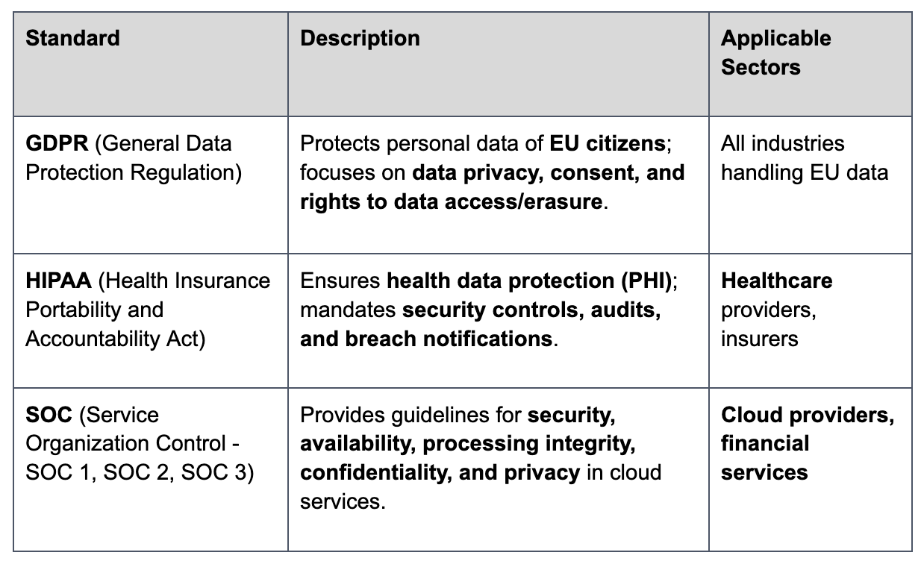
Key Standards Explained

Slide 25
Do not edit
How to change the design
Which of the following standards focuses specifically on protecting healthcare data?
Presenting with animations, GIFs or speaker notes? Enable our Chrome extension
Notes:
📣 This is Slido interaction slide, please don't delete it. ✅ Click on 'Present with Slido' and the poll will launch automatically when you get to this slide.

